Slide 1
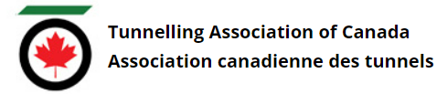
Tunnelling Association of Canada
Equity, Diversity, and Inclusion Moment
Unconscious Bias

Slide 2
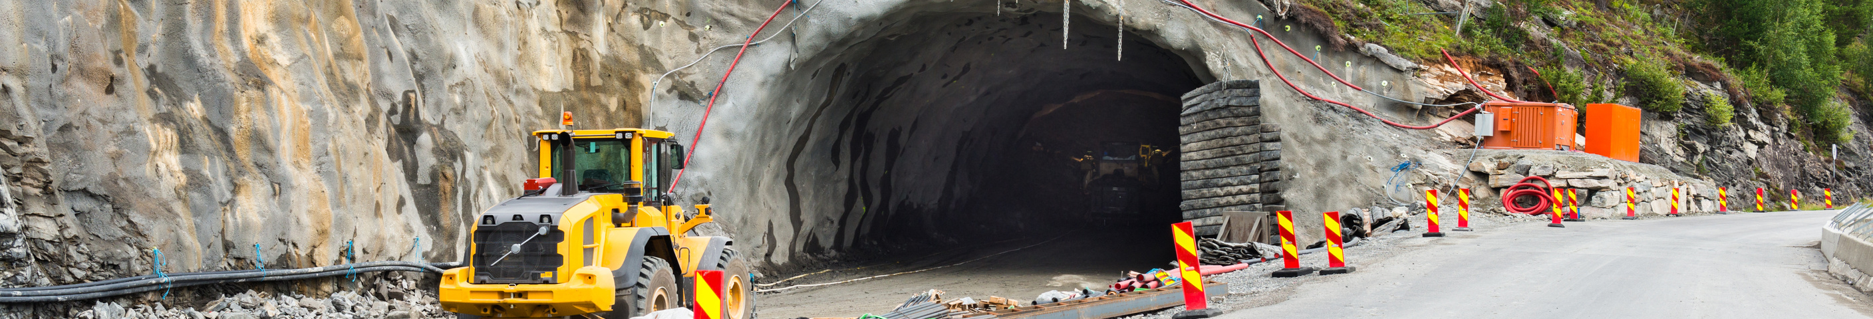
Tunnelling Association of Canada
What is unconscious bias?
Unconscious biases (also known as implicit biases) are attitudes or beliefs about certain groups of people that individuals form outside their own conscious awareness.
2

Slide 3
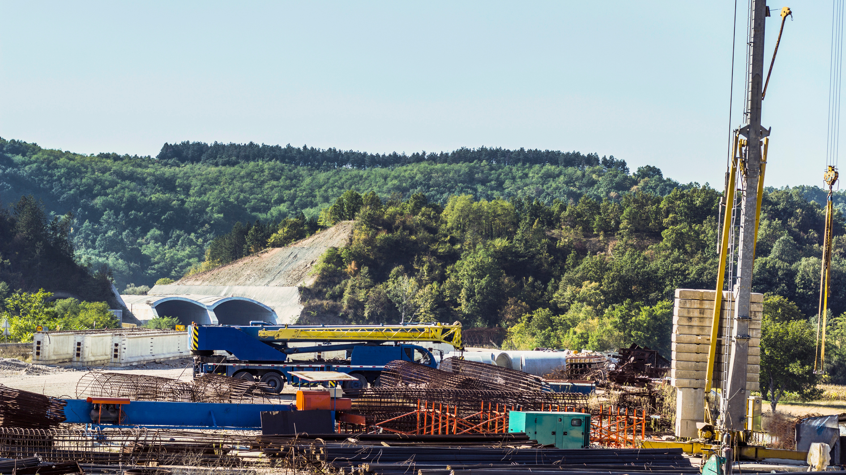
Tunnelling Association of Canada
How does it impact our workplace?
People may unknowingly let unconscious biases influence their actions which can prevent diverse cultures from entering or thriving in the workplace.
For example, in the hiring process, managers conducting interviews can unknowingly fall victim to their biases. This can affect their decision to hire a candidate based on their subconscious attitude towards that person.
3

Slide 4

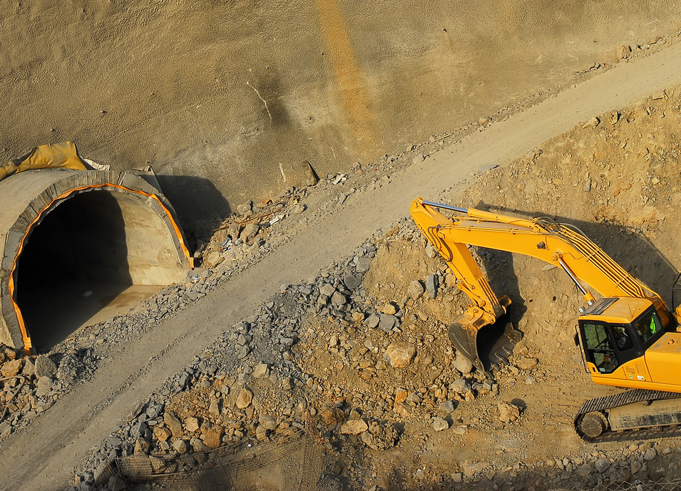
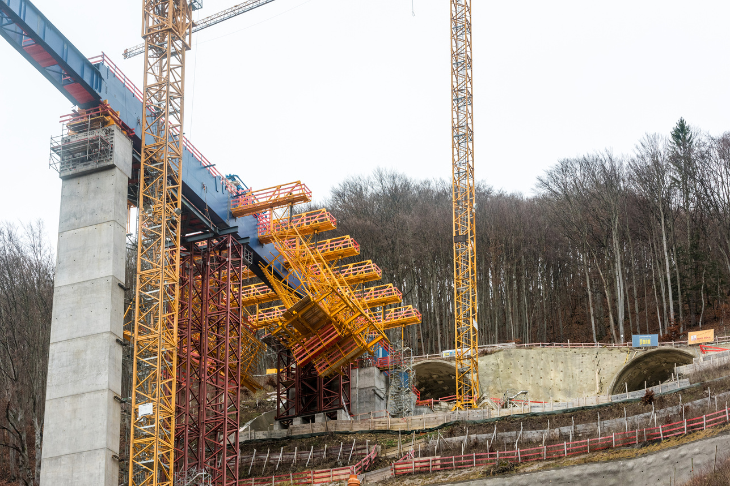
Tunnelling Association of Canada
Example of Unconscious Biases
Unconscious bias can exist related to any or all of the following:
Age
Weight
Race
Gender
Beauty
Name
Height
Religion
Culture
4

Slide 5
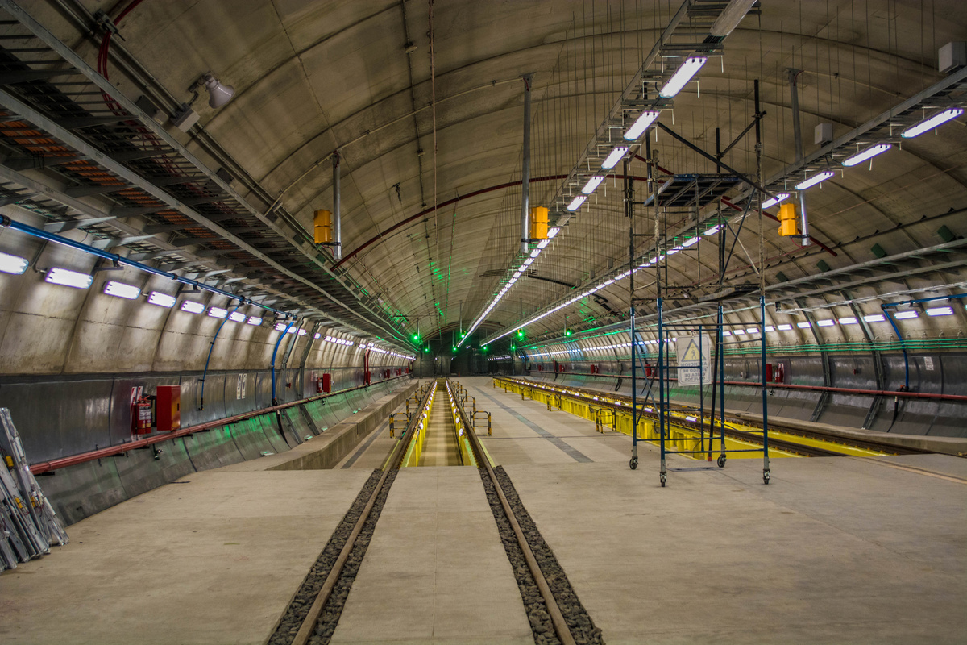
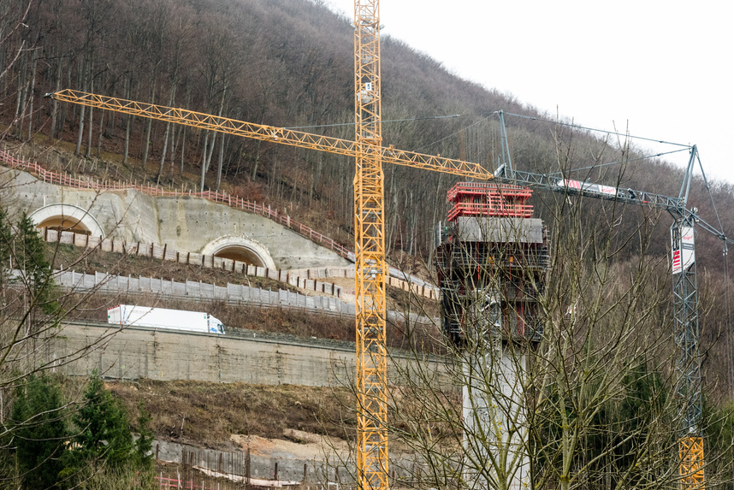
Tunnelling Association of Canada
Tips on How to Avoid Unconscious Bias
Identify Your Biases
Learn about your own biases through tests and training.
Use Strategies to Avoid the Influence of Unconscious Bias
Setting out and agreeing on decision making criteria ahead of making decisions is a proven way to avoid unconscious bias influencing decision making.
5

Slide 6
Tunnelling Association of Canada
Date
Thank you!
The End

